Slide 1

Natural Language Processing
An Introduction to
Dr. U. Kanimozhi
Senior Data Scientist
Crayon Data

Slide 2
Agenda
Emerging AI Technologies
NLP - Definition
Core Components
Levels of NLP
Challenges in NLP
Applications & Datasets
Algorithms & Libraries
Pretrained Models
Applications - Examples across domains
Conclusion
Natural Language Processing

Slide 3
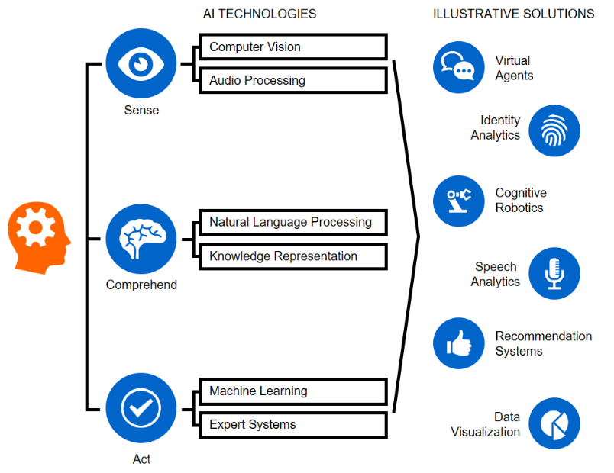
Emerging AI Technologies
Object detection in images or video streams
Conversational smart chatbots (text and speech)
Speech-to-text and text-to-speech
Assistive diagnostic solutions
Contextual data mining to discover complex patterns
Price optimisation
Data collection, curation and annotation for specific business use
Supply and demand forecasting
Server, app and web uptime/downtime prediction.
Source

Slide 4
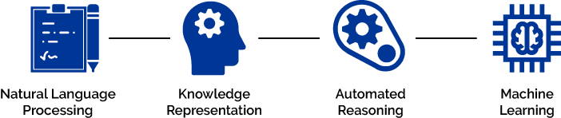
Types of AI
Artificial Narrow Intelligence (ANI)
Comprises of basic/role tasks such as those performed by chatbots, personal assistants like SIRI (Apple) and Alexa (Amazon).
Artificial General Intelligence (AGI)
Comprises of human-level tasks: self-driving cars (Uber), Autopilot (Tesla), Waymo (Google)
Involves continual learning by the machines.
Artificial Super Intelligence (ASI)
Refers to intelligence way smarter than humans.
WHAT MAKES SYSTEM AI ENABLED

Slide 5
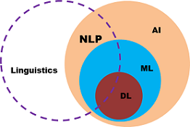
Natural Language Processing (NLP)
NLP is a field at the intersection of
computer science
artificial intelligence
linguistics
Goal: Computers to process or “understand” natural language in order to perform tasks that are useful
Performing Tasks, like making appointments, buying things
Language translation
Question Answering
Siri, Google Assistant, Amazon's Alexa, Facebook M, Cortana …
Fully understanding and representing the meaning of language (or even defining it) is a difficult goal
Perfect language understanding is AI-complete

Slide 6
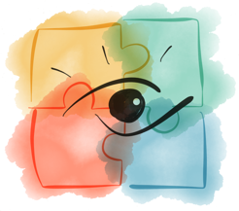


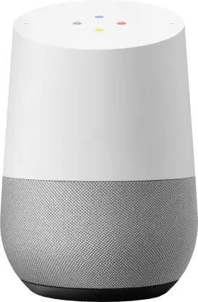
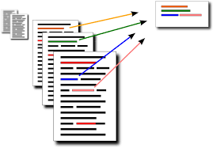




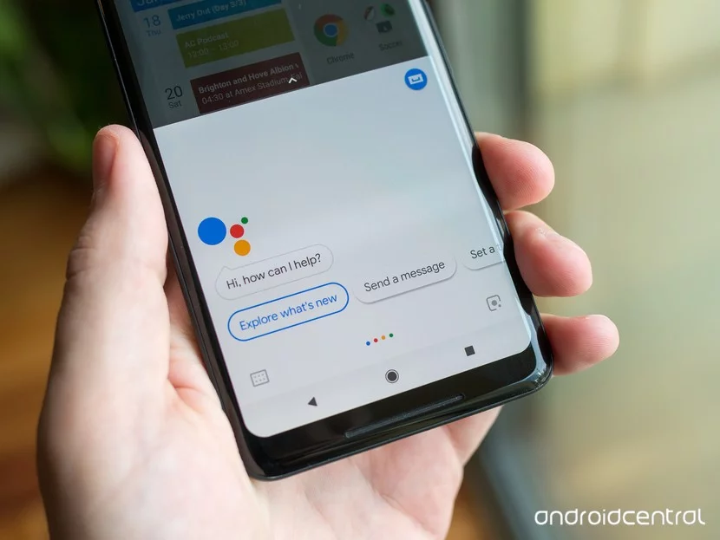
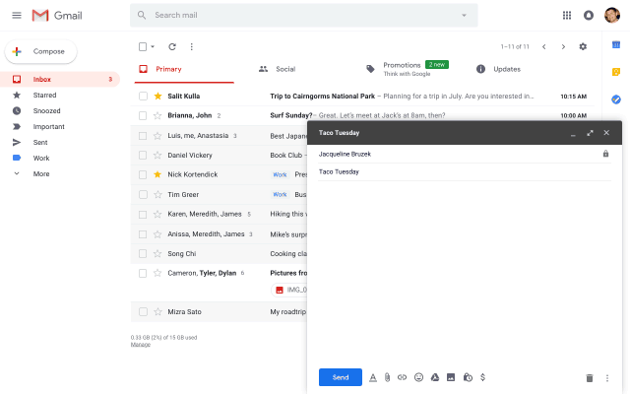
Jigsaw master class series

Slide 7
NLP Terminologies
Phonology: Organizing sound systematically.
Morphology: Construction of words from primitive meaningful units.
Morpheme: Primitive unit of meaning in a language.
Syntax: Arranging words to make a sentence. Involves determining the structural role of words in the sentence and in phrases.
Semantics: Concerned with the meaning of words and how to combine words into meaningful phrases and sentences.
Pragmatics: Deals with using and understanding sentences in different situations and how the interpretation of the sentence is affected.
Discourse: Deals with how the immediately preceding sentence can affect the interpretation of the next sentence.
World Knowledge: General knowledge about the world.

Slide 8
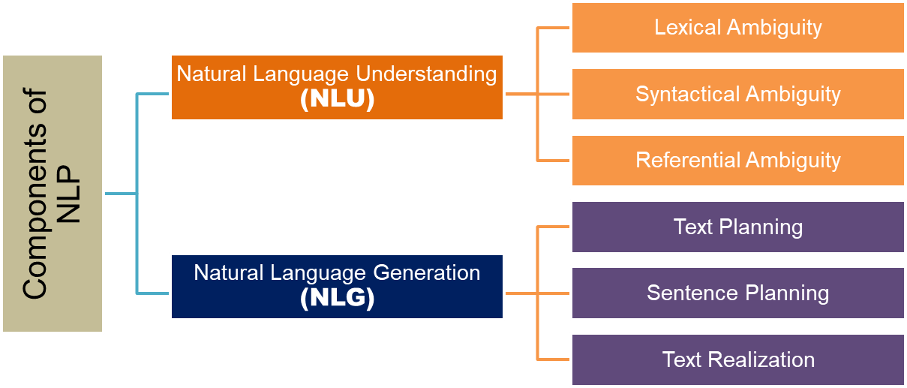
Core Components of NLP

Slide 9
NLU
Understand the meaning of the given text.
The nature and structure of each word inside text must be known for NLU.
Understanding structure involves resolving,
Lexical Ambiguity: Words have multiple meanings
Syntactic Ambiguity: Sentence is having multiple parse trees
Semantic Ambiguity: Sentence having multiple meanings
Anaphoric Ambiguity: Phrase or word which is previously mentioned but has a different meaning
Sense of each word is understood
Lexicons (vocabulary)
Set of grammatical rules
Similar meaning (synonyms)
Words having more than one meaning (polysemy)

Slide 10
NLG
Automatically producing text from structured data in a readable format with meaningful phrases and sentences.
Stages of NLG
Text Planning
Ordering of the primary content in structured data.
Sentence Planning:
Combining sentences with structured data to represent the flow of information.
Realization:
Producing grammatically correct sentences to represent text.
NLG Example

Slide 11
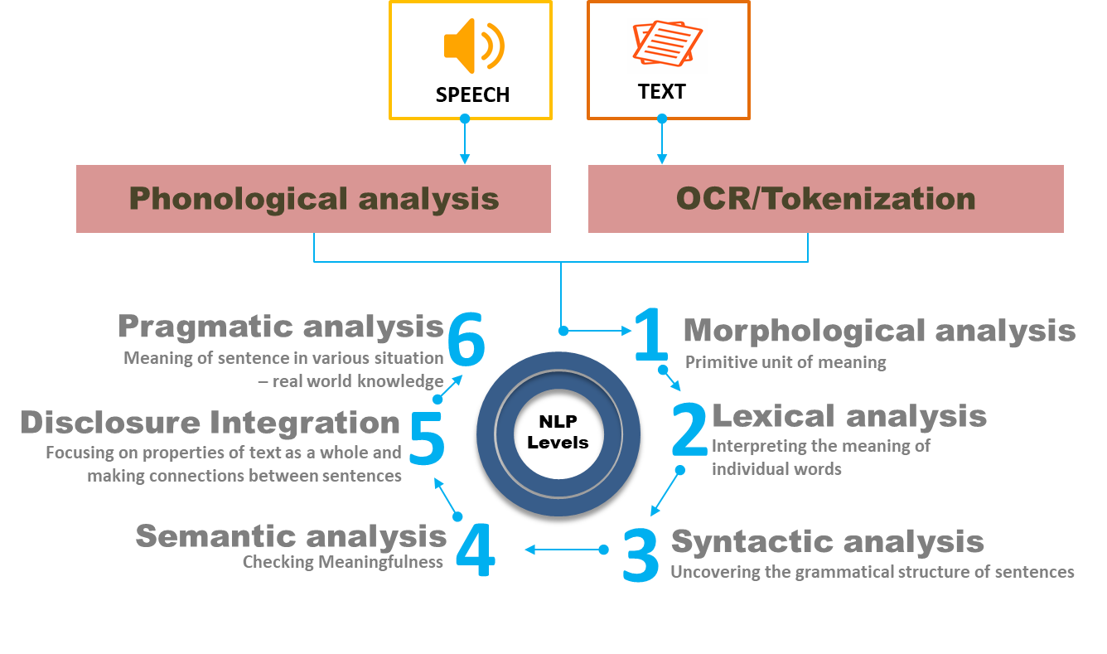
Levels of NLP

Slide 12
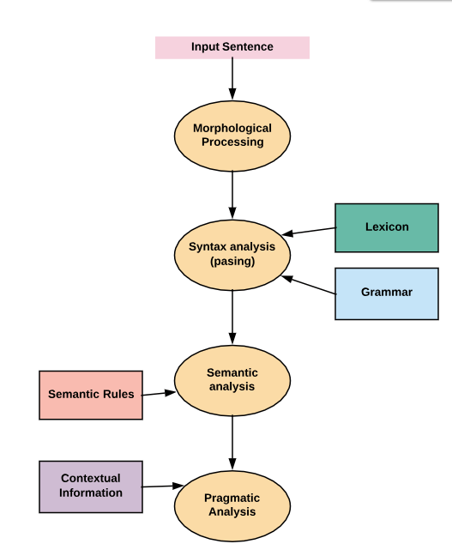
Steps in performing NLP tasks
Phonological Analysis
Morphological Analysis
Lexical Analysis
Stemming
Lemmatization
Syntactic Analysis
Semantic Analysis
Discourse Integration
Pragmatic Analysis

Slide 13
Phonological Analysis
Applied only if the text origin is a speech.
Deals with the interpretation of speech sounds within and across words.
Speech sound might give a big hint about the meaning of a word or a sentence.
Organizing sound systematically.
This requires a broad discussion and is out of scope of our current note.

Slide 14
Morphological Analysis
Understanding distinct words according to their morphemes (the smallest units of meanings).
Example, “unhappiness ”.
Broken down into three morphemes (prefix, stem, and suffix),
prefix un- refers to “not being”,
stem happy is considered as a free morpheme since it is a “word” in its own right.
suffix -ness refers to “a state of being”.
Bound morphemes (prefixes and suffixes) - E.g., "un-", "break", and "-able"
Require a free morpheme to which it can be attached to
Not appear as a “word” on their own

Slide 15
Lexical Analysis
Identifying and analysing the structure of words.
Lexicon of a language means the collection of words and phrases in a language.
Dividing the whole chunk of text into paragraphs, sentences, and words.
Lexicon Normalization
Stemming
stripping the suffixes (“ing”, “ly”, “es”, “s” etc) from a word
Lemmatization
Obtaining the root form of the word
Vocabulary (dictionary importance of words)
Morphological analysis (word structure and grammar relations)

Slide 16
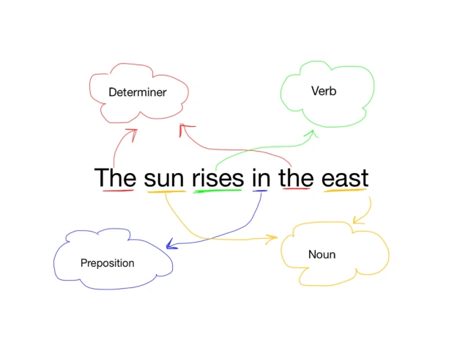
Syntactic Analysis
Syntactic parsing involves,
Analysis of words in the sentence for grammar
Arrangement in a manner that shows the relationships among the words
Important attributes of text syntactics
Dependency Grammar
Part of Speech tags

Slide 17
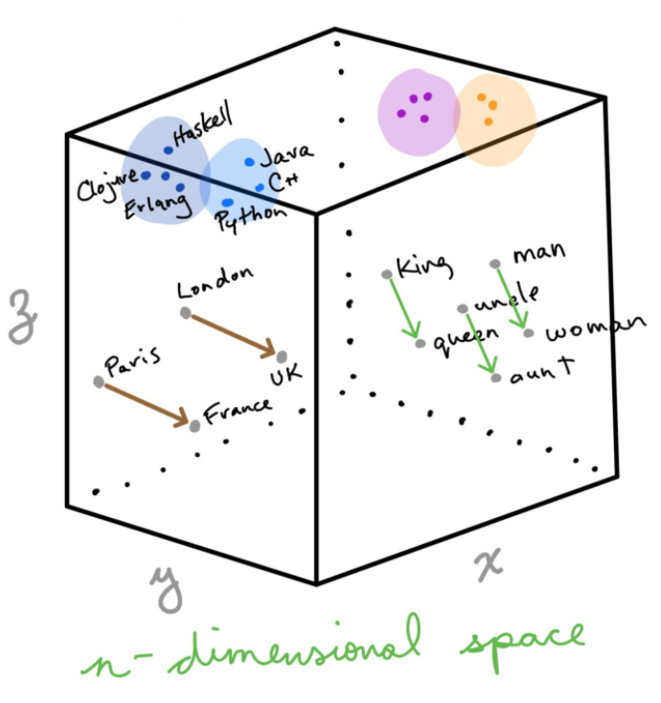
Semantic Analysis
Determines the possible meanings of a sentence by focusing on the interactions among word-level meanings in the sentence.
Distributional Representation
Word2vec, GloVe, fastText
Frame semantics
Model-theoretical
Interactive Learning
Embedding Projector

Slide 18
Discourse Integration
Properties of the text as a whole that convey meaning by making connections between component sentences.
Sense of the context.
The meaning of any single sentence which depends upon that sentence. Also, considers the meaning of the following sentence.
Example:
the word "that" in the sentence "He wanted that" depends upon the prior discourse context.

Slide 19
Pragmatic Analysis
Explains how extra meaning is read into texts without actually being encoded in them.
World knowledge: Understanding of intentions, plans, and goals.
Consider the following two sentences:
The city police refused the demonstrators a permit because they feared violence.
The city police refused the demonstrators a permit because they advocated revolution.
Helps users to discover this intended effect by applying a set of rules that characterize cooperative dialogues.
E.g., "close the window?"
should be interpreted as a request instead of an order.

Slide 20
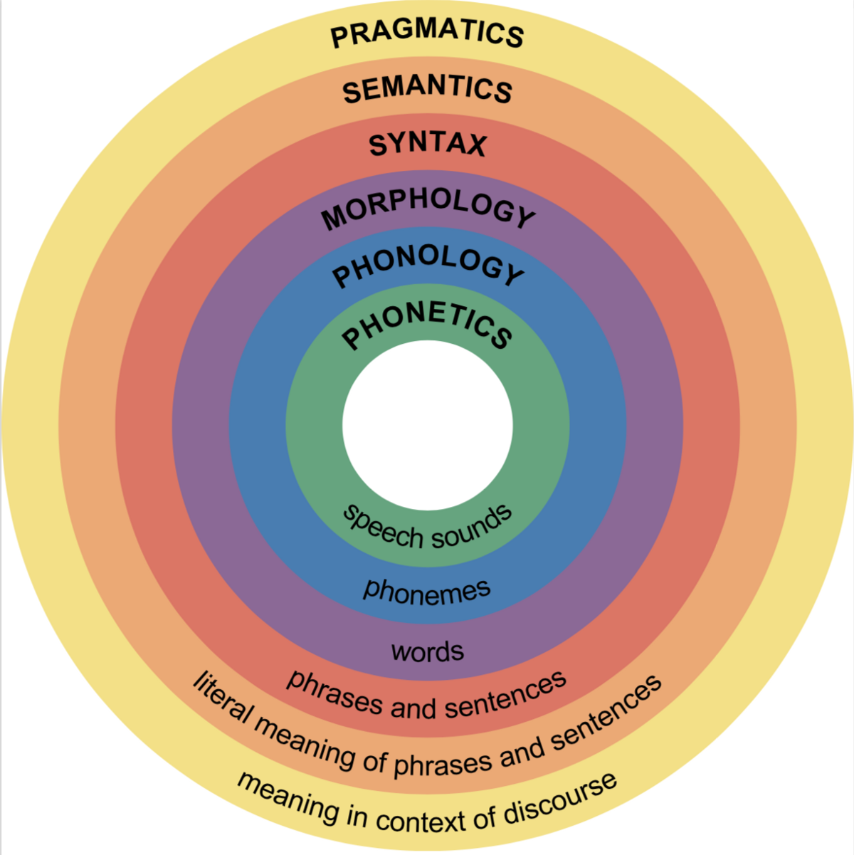

Slide 21
Why it is difficult to work with text?
Comprehending language is tough for computers
Few of the common challenges in NLP
Synonymy
Lexical Ambiguity
Language related issue
Referential Ambiguity
Out of Vocabulary problem
Language generation

Slide 22
Why NLP is hard?
Synonymy
As in different words having the same meaning.
S1: “The President of the United States has signed a new decree”
S2: “POTUS has inked in a new law”
Both these statements are advocating the same sentiment.
Completely different sentences syntactically, computers have a hard time figuring out the user intent.

Slide 23
Why NLP is hard?
Lexical Ambiguity
Lack of clarity of the same word being used in different contexts.
When a word carries different sense
Having more than one meaning and the sentence in which it is contained can be interpreted differently depending on its correct sense.
S1: “The bank deposit rate is quite high”
S2: “He stood near the bank admiring the river”.
What do you understand by ‘match’?
Partner or Cricket/Football Match
S3: He is looking for a match

Slide 24
Why NLP is hard?
Language related issues
Every language has its uniqueness.
English - do not have a gender associated with the noun ‘bread’.
Russian language, each noun is assigned a gender (masculine, feminine, or neuter ) And bread is ‘Masculine’ !!
The grammar and morphology of languages are so different and unique making it tough for machines to understand the language.

Slide 25
Why NLP is hard?
Out of Vocabulary problem
Machines can only handle data that they have seen before.
It is unable to adapt well to new words. (Unsupervised problem)
Language generation
For chatbots to work effectively, they need to first understand the constructed sentences which are grammatically correct, understand its meaning and context and effectively reply to customer queries.

Slide 26
Why NLP is hard?
Syntactic Ambiguity/ grammatical ambiguity
When we see more than one meaning in a sequence of words.
Is the chicken ready to eat his food or the chicken is ready for someone else to it?
You never know.
The chicken is ready to eat.

Slide 27
Why NLP is hard?
Referential Ambiguity
Very often a text mentions as entity (something/someone), and then refers to it again, possibly in a different sentence, using another word.
Pronoun causing ambiguity when it is not clear which noun it is referring to.
S1: “Jeff is my friend. He likes to sell”.
It is difficult for the computers to decipher what person/entity the pronoun he is referring to.
They refer to Jane and Teresa or all?
S2: Jane met Teresa and Harvey. They went to restaurant

Slide 28
Why else is NLU difficult?
non-standard English
Great job @justinbieber! Were SOO PROUD of what youve accomplished! U taught us 2 #neversaynever & you yourself should never give up either♥
segmentation issues
the New York-New Haven Railroad
the New York - New Haven Railroad
idioms
dark horse
get cold feet
lose face
throw in the towel
neologisms
unfriend
Retweet
bromance
world knowledge
Mary and Sue are sisters.
Mary and Sue are mothers.
tricky entity names
Where is A Bug’s Life playing …
Let It Be was recorded …
… a mutation on the for gene …

Slide 29
Applications
Progress in NLP
3 Categories
Real time Examples

Slide 30
DeepNLP = Deep Learning + NLP
Combine ideas and goals of NLP with using representation learning and deep learning methods to solve them
Several big improvements in recent years in NLP
Linguistic levels: (speech), words, syntax, semantics
Intermediate tasks/tools: parts-of-speech, entities, parsing
Full applications: sentiment analysis, question answering, dialogue agents, machine translation
Trends of ACL

Slide 31


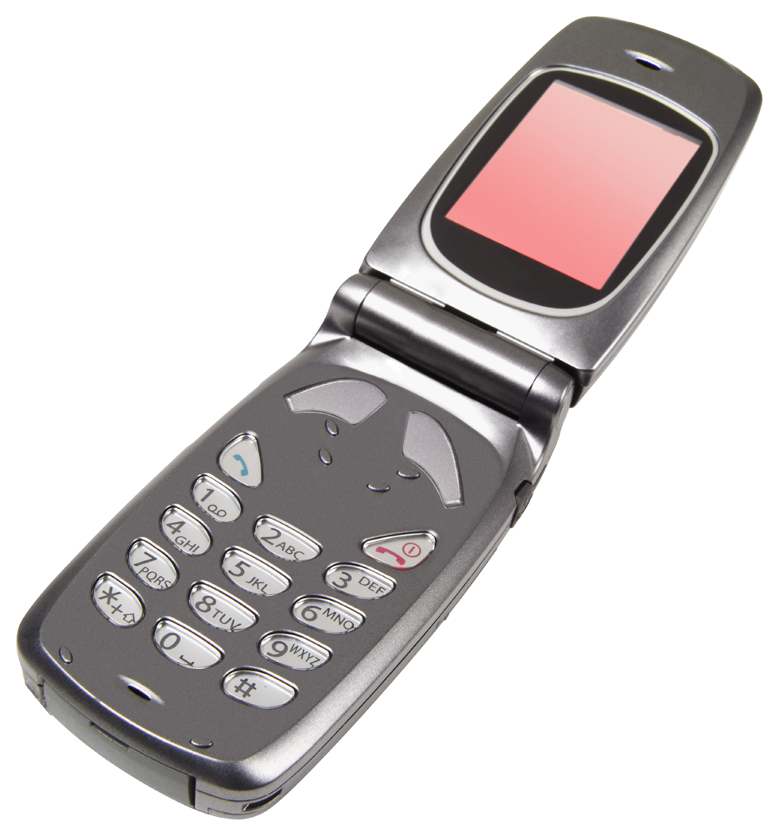

Language Technology
making good progress
Sentiment analysis
still really hard
mostly solved
Best roast chicken in San Francisco!
Question answering (QA)
The waiter ignored us for 20 minutes.
Spam detection
Coreference resolution
Q. How effective is ibuprofen in reducing fever in patients with acute febrile illness?
✓
Let’s go to Agra!
Paraphrase
✗
Carter told Mubarak he shouldn’t run again.
Buy V1AGRA …
Word sense disambiguation (WSD)
XYZ acquired ABC yesterday
Part-of-speech (POS) tagging
I need new batteries for my mouse.
ABC has been taken over by XYZ
ADJ ADJ NOUN VERB ADV
Summarization
Colorless green ideas sleep furiously.
Parsing
The Dow Jones is up
Economy is good
I can see Alcatraz from the window!
The S&P500 jumped
Named entity recognition (NER)
Machine translation (MT)
Housing prices rose
PERSON ORG LOC
第13届上海国际电影节开幕…
Dialog
Where is Citizen Kane playing in SF?
Einstein met with UN officials in Princeton
The 13th Shanghai International Film Festival…
Information extraction (IE)
Castro Theatre at 7:30. Do you want a ticket?
You’re invited to our dinner party, Friday May 27 at 8:30
Party May 27 add

Slide 32
NLP Applications: Language Technology
Group 1
Group 2
Group 3
Cleanup, Tokenization
Information Retrieval & Extraction
Machine Translation
Stemming, Lemmatization
Relationship Extraction
Summarization/Paraphrasing
Named Entity Recognition (NER)
Part of Speech Tagging
Language Generation
Sentiment Analysis/Sentence Boundary Disambiguation
Query Expansion
Reasoning over Knowledge Base
Word Sense Disambiguation
Parsing
Question Answering
Text Similarity
Topic Segmentation & Recognition
Dialogue Box
Coreference Resolution
Morphological Segmentation
(words/sentences)
Image Caption & other Multimodal Tasks
Discourse Analysis

Slide 33
Application - Examples
Information Retrieval
Google finds relevant and similar results.
Information Extraction
Gmail structures events from emails.
Machine Translation
Google Translate translates language from one language to another.
Text Simplification
Rewordify simplifies the meaning of sentences.
Sentiment Analysis
Hater News gives us the sentiment of the user.

Slide 34
Application - Examples
Text Summarization
Smmry or Reddit’s autotldr gives a summary of sentences.
Spam Filter
Gmail filters spam emails separately.
Auto-Predict
Google Search predicts user search results.
Auto-Correct
(Google Keyboard and Grammarly correct words otherwise spelled wrong.
Speech Recognition
Google WebSpeech or Vocalware.
Question Answering
IBM Watson’s answers to a query; Google's T5 Model
Natural Language Generation
Generation of text from image or video data.

Slide 35
NLP
Functionalities & Datasets
Corpus
Libraries
Algorithms

Slide 36
Datasets
The Big Bad NLP Database
The Super Duper NLP Repo
Google Dataset Search
PytorchNLP
General Language Understanding Evaluation (GLUE) benchmark
Datalist
Datasets_Desc_GLUe

Slide 37
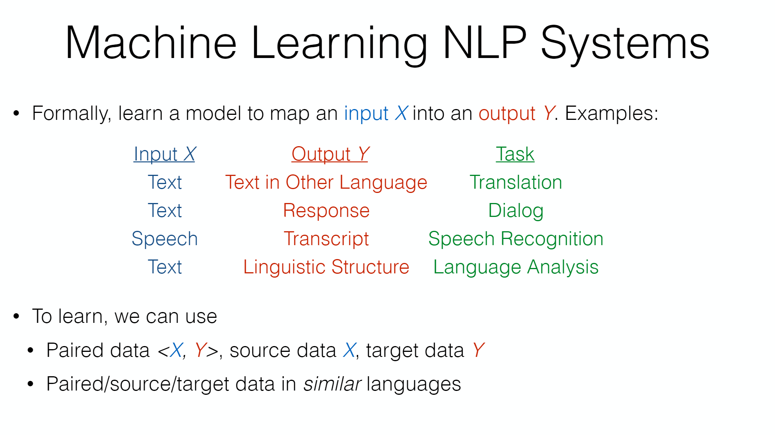
Jigsaw master class series

Slide 38
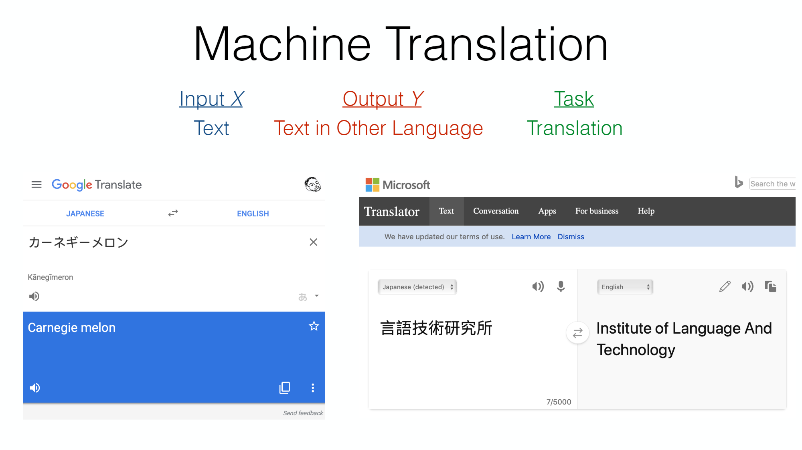
Jigsaw master class series

Slide 39
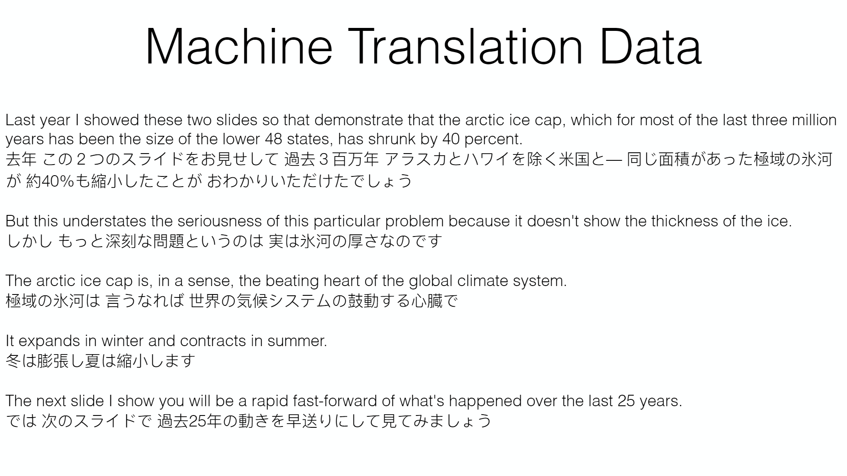
Jigsaw master class series

Slide 40
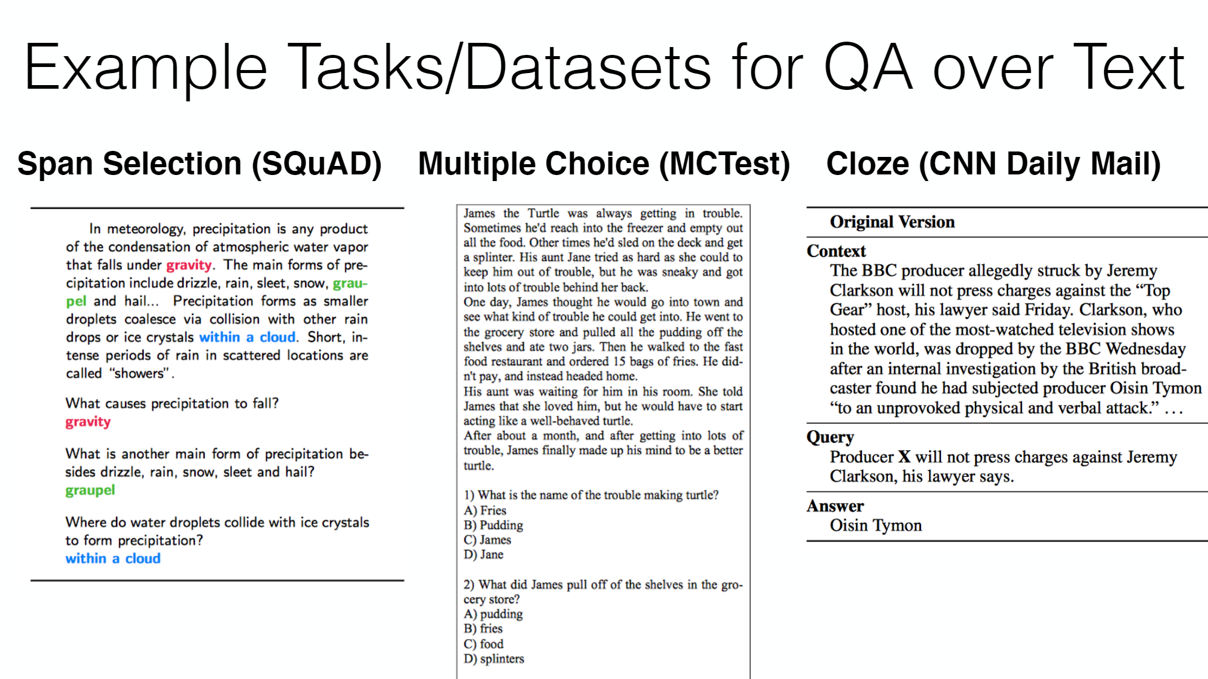
Jigsaw master class series

Slide 41
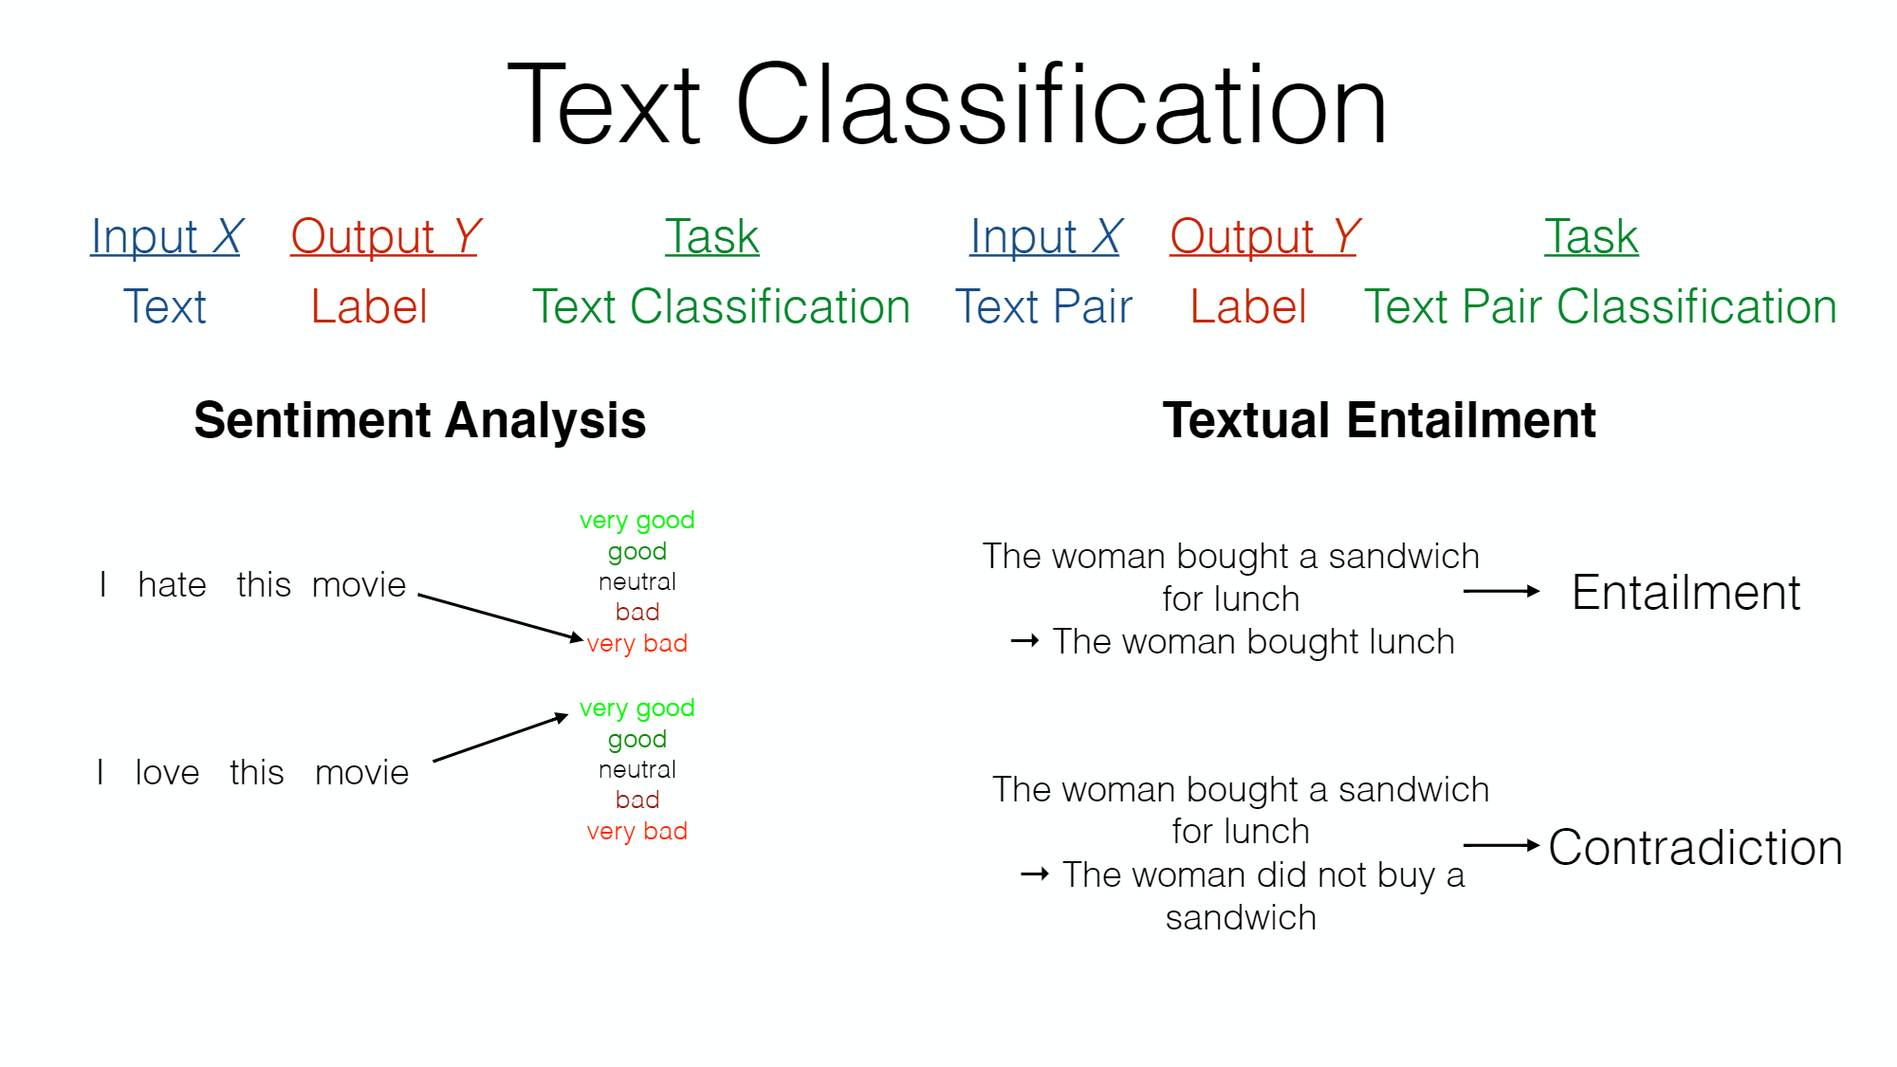
Jigsaw master class series

Slide 42
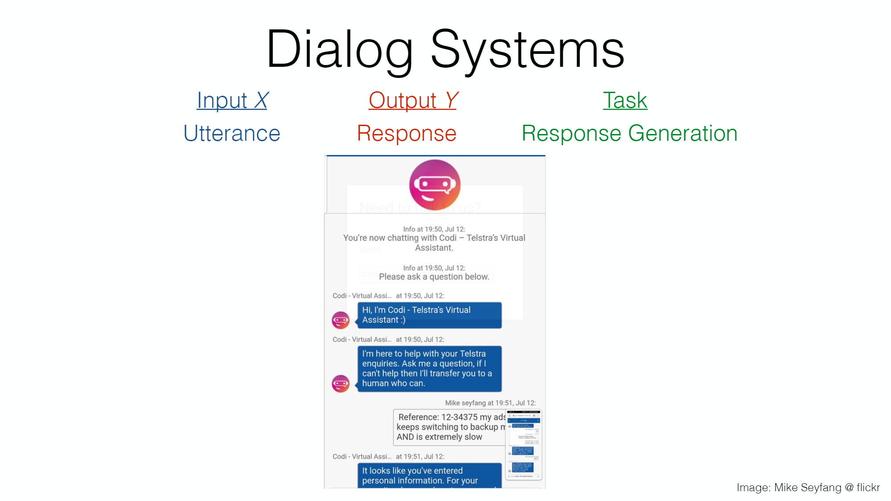
Jigsaw master class series

Slide 43
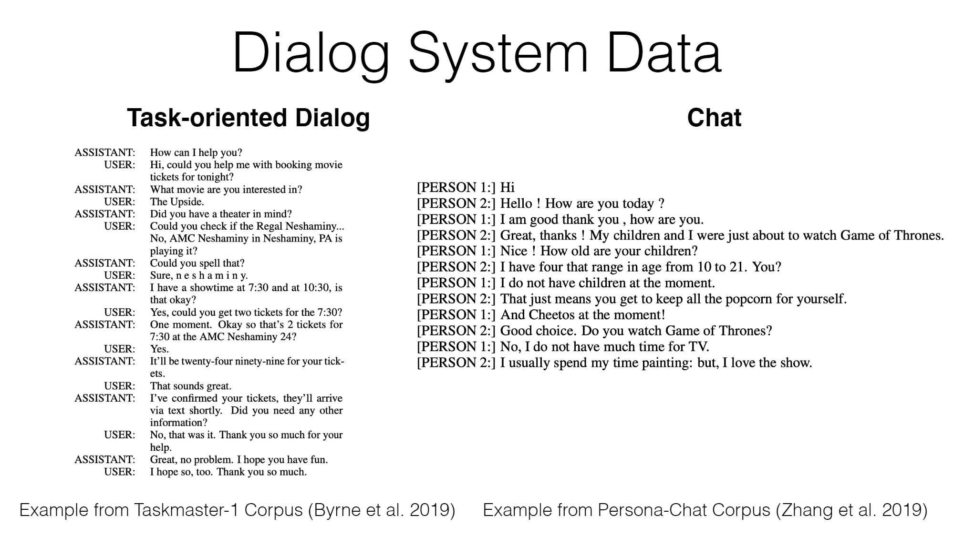
Jigsaw master class series

Slide 44
General Sentiment Analysis GLUe
Enron Dataset:
Over half a million anonymized emails from over 100 users. It’s one of the few publically available collections of “real” emails available for study and training sets.
Google Blogger Corpus: Nearly 700,000 blog posts from blogger.com. The meat of the blogs contain commonly occurring English words, at least 200 of them in each entry.
SMS Spam Collection: Excellent dataset focused on spam. Nearly 6000 messages tagged as legitimate or spam messages with a useful subset extracted directly from Grumbletext.
Recommender Systems Datasets: Datasets from a variety of sources, including fitness tracking, video games, song data, and social media. Labels include star ratings, time stamps, social networks, and images.
Project Gutenberg: Extensive collection of book texts. These are public domain and available in a variety of languages, spanning a long period of time
Grammatical acceptability - CoLA
Sentiment analysis - SST-2
Paraphrase identification - MRPC
Semantic similarity - STS-B
Question duplication detection with Quora Question Pairs
Textual Entailment - MNLI-matched, [MNLI-mismatched] (https://cims.nyu.edu/~sbowman/multinli/)
Recognizing Textual Entailment - RTE
Question answering - SQuAD
Pronoun disambiguation - Winograd Challenge dataset
Sentiment 140: 160,000 tweets scrubbed of emoticons. They’re arranged in six fields — polarity, tweet date, user, text, query, and ID.
MultiDomain Sentiment Analysis Dataset: Includes a wide range of Amazon reviews. Dataset can be converted to binary labels based on star review, and some product categories have thousands of entries.
Yelp Reviews: Restaurant rankings and reviews. It includes a variety of aspects including reviews for sentiment analysis plus a challenge with cash prizes for those working with Yelp’s datasets.
Dictionaries for Movies and Finance: Specific dictionaries for sentiment analysis using a specific field for testing data. Entries are clean and arranged in positive or negative connotations.
OpinRank Dataset: 300,000 reviews from Edmunds and TripAdvisor. They’re neatly arranged by car model or by travel destination and relevant to the hotel.

Slide 45
Text Speech
20 Newsgroups: 20,000 documents from over 20 different newsgroups. The content covers a variety of topics with some closely related for reference. There are three versions, one in its original form, one with dates removed, and one with duplicates removed.
The WikiQA Corpus: Contains question and sentence pairs. It’s robust and compiled from Bing query logs. There are over 3000 questions and over 29,000 answer sentences with just under 1500 labeled as answer sentences.
European Parliament Proceedings Parallel Corpus: Sentence pairs from Parliament proceedings. There are entries from 21 European languages including some less common entries for ML corpus.
Jeopardy: Over 200,000 questions from the famed tv show. It includes category and value designations as well as other descriptors like question and answer fields and rounds.
Legal Case Reports Dataset: Text summaries of legal cases. It contains wrap ups of over 4000 legal cases and could be great for training for automatic text summarization.
LibriSpeech: Nearly 1000 hours of speech in English taken from audiobook clips.
Spoken Wikipedia Corpora: Spoken articles from Wikipedia in three languages, English, German, and Dutch. It includes a diverse speaker set and range of topics. There are hundreds of hours available for training sets.
LJ Speech Dataset: 13,100 clips of short passages from audiobooks. They vary in length but contain a single speaker and include a transcription of the audio, which has been verified by a human reader.
M-AI Labs Speech Dataset: Nearly 1000 hours of audio plus transcriptions. It includes multiple languages arranged by male voices, female voices, and a mix of the two.
Noisy Speech Database: Noisy and Clean parallel speech dataset. It’s designed for building speech enhancement software but could be valuable as a training dataset for speech outside of ideal conditions.

Slide 46
Algorithms
NLP Background - Text Mining
NLP - Tasks (Deep Learning)

Slide 47
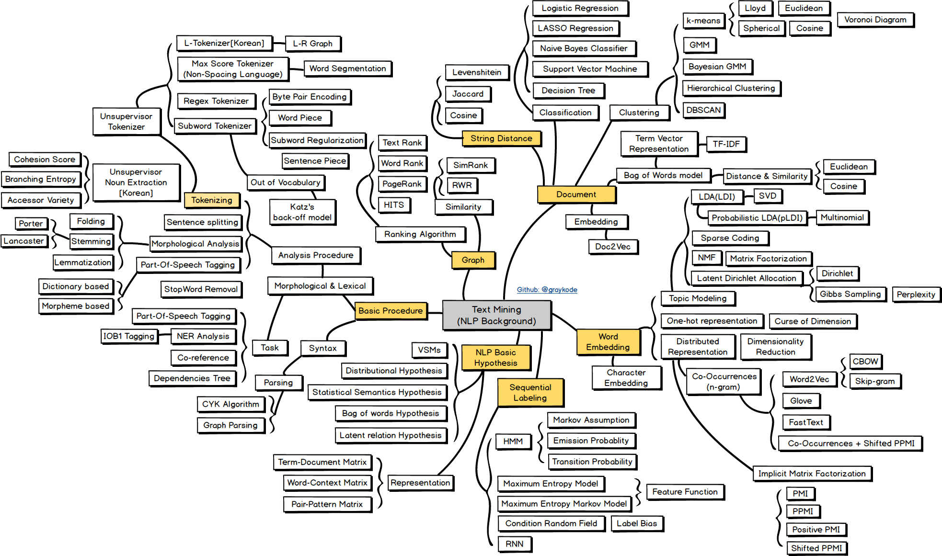
Jigsaw master class series
Source

Slide 48
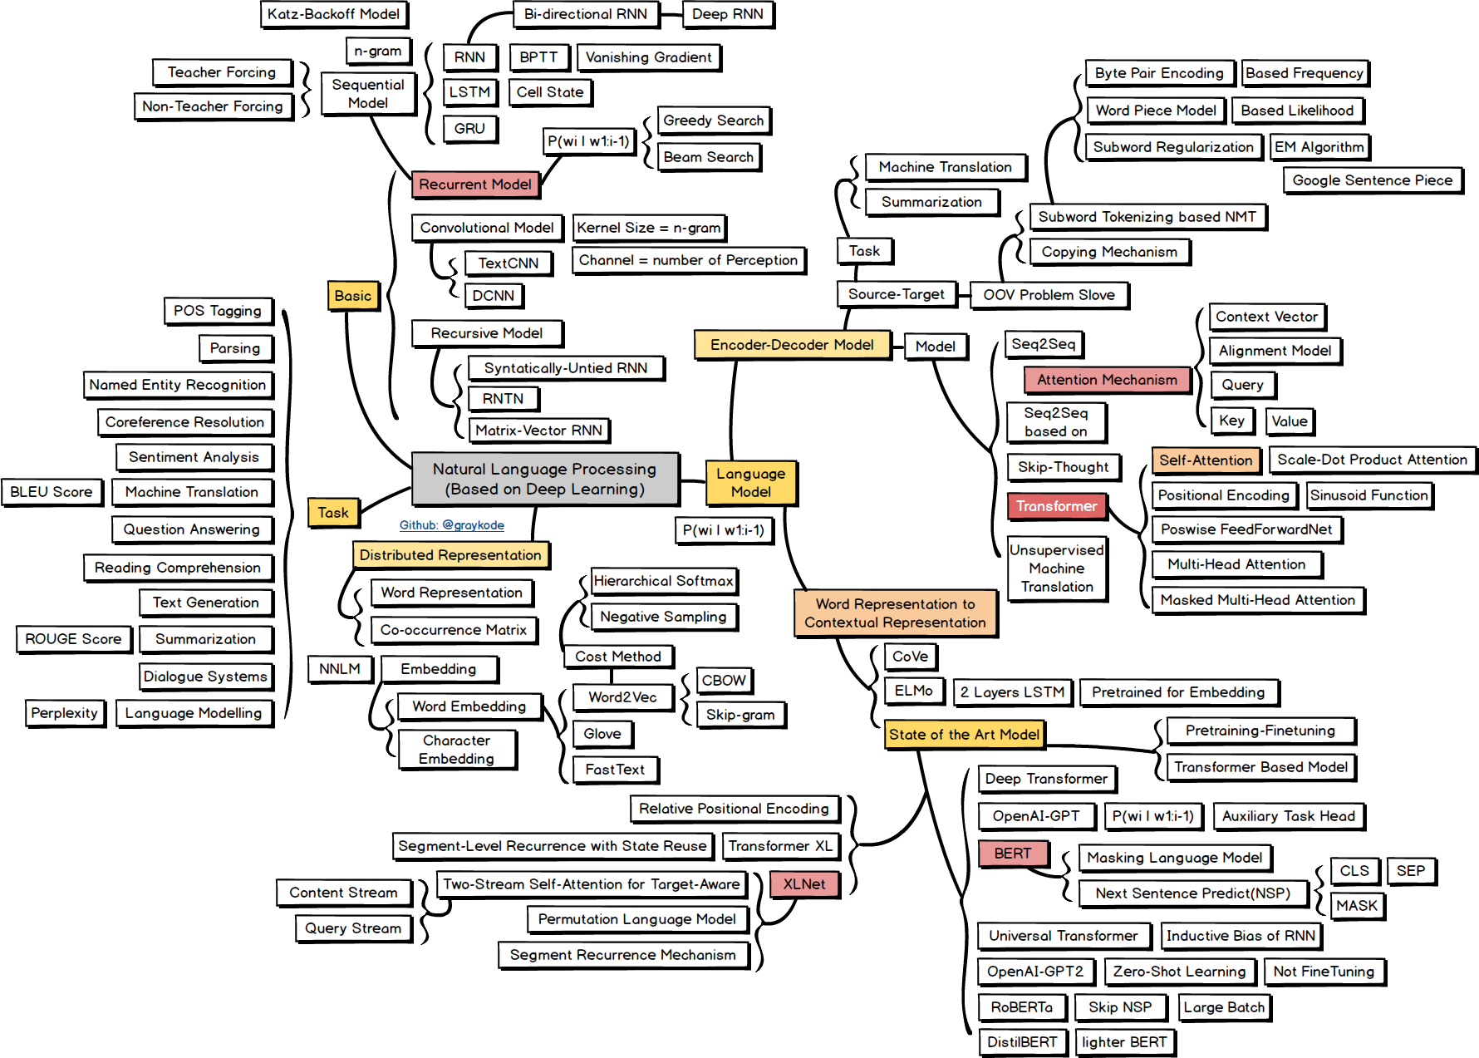
Source
master class series

Slide 49
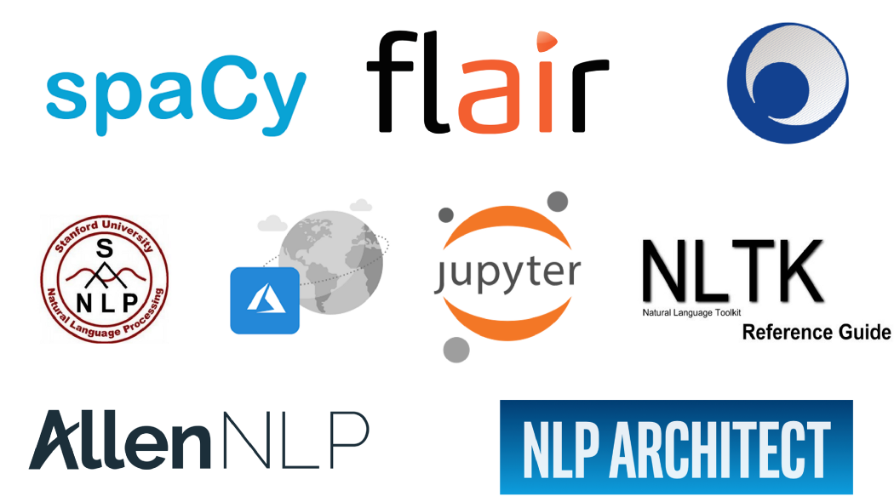


Jigsaw master class series
Notes:
https://medium.com/microsoftazure/7-amazing-open-source-nlp-tools-to-try-with-notebooks-in-2019-c9eec058d9f1

Slide 50

Libraries
Core feature set:
Sentence detection
Tokenization
Stemming
Lemmatization
Part of speech (POS)
Named entity recognition (NER)
Dependency parser
Training domain-specific models
Also provide some or all of these features:
Spell checking
Sentiment analysis
Text matcher
Date matcher
Chunking
Other features
NLTK
Gensim
polyglot
TextBlob
CoreNLP
spaCy
Pattern
Vocabulary
PyNLPl
Quepy
Standalone packages
Plugins
Extensions
Educational materials
Operational utilities
Bindings for other languages

Slide 51
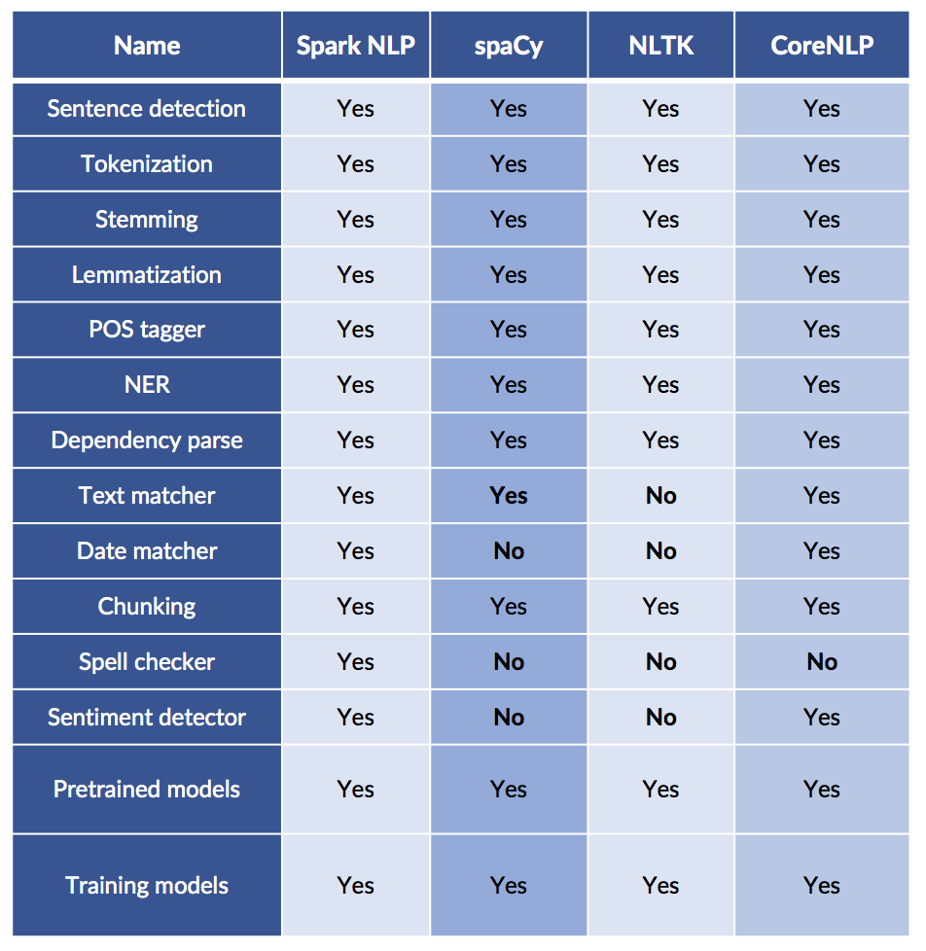
Functionalies
Production-grade software
Spark NLP
spaCy
NLTK
OpenNLP
Stanford CoreNLP

Slide 52
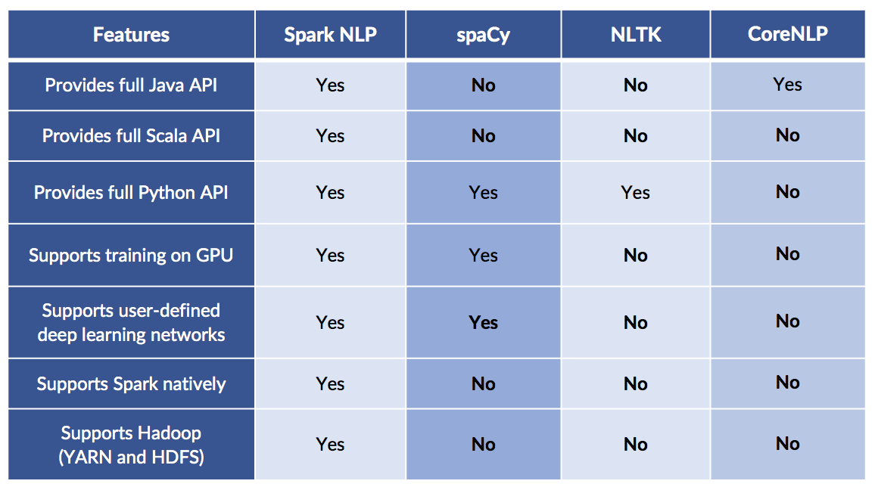
Technical Functionality

Slide 53
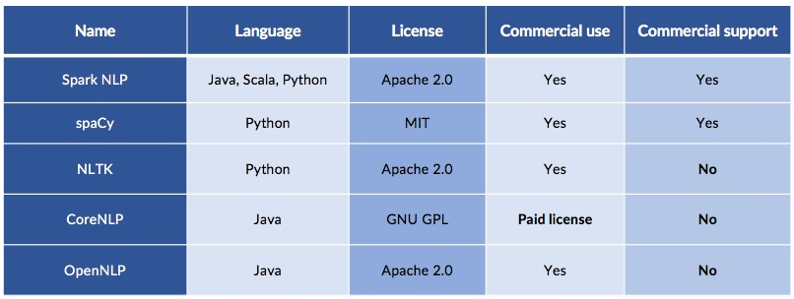
Licensing and support
Source

Slide 54
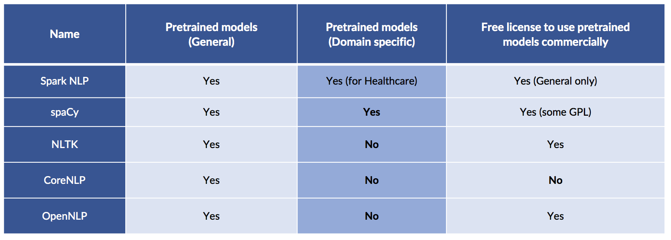
Pretrained Models

Slide 55
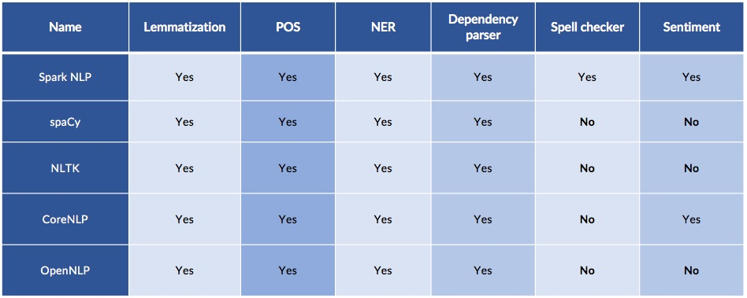
General pretrained models
Notes:
https://blog.dominodatalab.com/comparing-the-functionality-of-open-source-natural-language-processing-libraries/

Slide 56
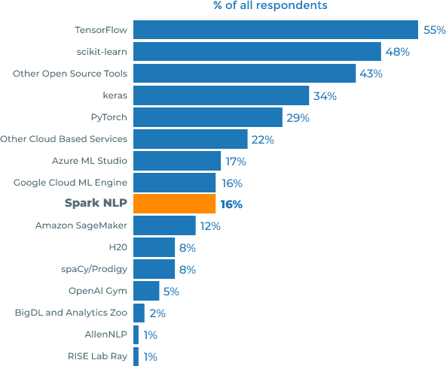
NLP libraries in the enterprise
“AI Adoption in the Enterprise”, Survey of 1300 Practitioners by O’Reilly, Published February 2019.
The 2020 survey reproduced the same outcome.
Comparing accuracy, speed and scalability

Slide 57








Standalone Packages, plugins, extensions
ADAM: Question Answering System
A question answering system that extracts answers from Wikipedia to questions posed in natural language.
alibi
Algorithms for monitoring and explaining machine learning models
AllenNLP
An open-source NLP research library, built on PyTorch and spaCy
Blackstone
A spaCy pipeline and model for NLP on unstructured legal text
Chatterbot
A machine-learning based conversational dialog engine for creating chat bots
Dframcy
Dataframe Integration with spaCy NLP
Contextual Spell Check
Contextual spell correction using BERT (bidirectional representations)
cookiecutter-spacy-fastapi
Docker-based cookiecutter for easy spaCy APIs using FastAPI
displaCy
A modern syntactic dependency visualizer

Slide 58
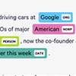


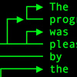




Standalone Packages, plugins, extensions
displaCy ENT
A modern named entity visualizer
Dragonfire
An open-source virtual assistant for Ubuntu based Linux distributions
EpiTator
Extracts case counts, resolved location/species/disease names, date ranges and more
ExcelCy
Excel Integration with spaCy. Training NER using XLSX from PDF, DOCX, PPT, PNG or JPG.
explacy
A small tool that explains spaCy parse results
gobbli
Deep learning for text classification doesn't have to be scary
gracyql
A thin GraphQL wrapper around spacy
Graphbrain
Automated meaning extraction and text understanding
Holmes
Information extraction from English and German texts based on predicate logic

Slide 59








Standalone Packages, plugins, extensions
lemminflect
A Python module for English lemmatization and inflection
Lemmy
A Danish lemmatizer
Ludwig
A code-free deep learning toolbox
Rule-based Matcher Explorer
Test spaCy's rule-based Matcher by creating token patterns interactively
MLflow
An open source platform for the machine learning lifecycle
mordecai
Full text geoparsing using spaCy, Geonames and Keras
negspaCy
spaCy pipeline object for negating concepts in text based on the NegEx algorithm.
neuralcoref
State-of-the-art coreference resolution based on neural nets and spaCy
Neuralcoref Visualizer
State-of-the-art coreference resolution based on neural nets and spaCy
NeuroNER
Named-entity recognition using neural networks
NLPre
Natural Language Preprocessing Library for health data and more
Numeric Fused-Head
Numeric Fused-Head Identification and Resolution in English

Slide 60




Standalone Packages, plugins, extensions
NeuralGym
A little Windows GUI for training models with spaCy
NLP Architect
Python lib for exploring Deep NLP & NLU by Intel AI
pic2phrase_bot: Photo Description Generator
A bot that generates descriptions to submitted photos, in a human-like manner.
Prefect
Workflow management system designed for modern infrastructure
Presidio
Context aware, pluggable and customizable data protection and PII data anonymization
Presidio Research
Toolbox for developing and evaluating PII detectors, NER models for PII and generating fake PII data
Prodigy
Radically efficient machine teaching, powered by active learning
PyATE
Python Automated Term Extraction
pyInflect
A Python module for word inflections
pySBD - python Sentence Boundary Disambiguation
Rule-based sentence boundary detection that works out-of-the-box

Slide 61





Standalone Packages, plugins, extensions
Rasa
Turn natural language into structured data
RONEC - Romanian Named Entity Corpus
Named Entity Recognition corpus for Romanian language.
saber
Deep-learning based tool for information extraction in the biomedical domain
scispaCy
A full spaCy pipeline and models for scientific/biomedical documents
sense2vec
Use NLP to go beyond vanilla word2vec
scattertext
Beautiful visualizations of how language differs among document types
Berkeley Neural Parser
Constituency Parsing with a Self-Attentive Encoder (ACL 2018)
spaCy-CLD
Add language detection to your spaCy pipeline using CLD2
Spacy FastLang
Language detection done fast
spacy_grammar
Language Tool style grammar handling with spaCy
spacy_hunspell
Add spellchecking and spelling suggestions to your spaCy pipeline using Hunspell
spacy_api
Server/client to load models in a separate, dedicated process

Slide 62


Standalone Packages, plugins, extensions
spacy_kenlm
KenLM extension for spaCy 2.0
spacy_readability
Add text readability meta data to Doc objects
Spacy Syllables
Multilingual syllable annotations
spacy-api-docker
spaCy REST API, wrapped in a Docker container
spacy-graphql
Query spaCy's linguistic annotations using GraphQL
spacy-cpp
C++ wrapper library for spaCy
spacy_conll
Parse text with spaCy and gets its output in CoNLL-U format
spacy-iwnlp
German lemmatization with IWNLP
spacy-js
JavaScript API for spaCy with Python REST API
spacy-langdetect
A fully customizable language detection pipeline for spaCy
spacy-lefff
POS and French lemmatization with Lefff
spacy-lookup
A powerful entity matcher for very large dictionaries, using the FlashText module

Slide 63


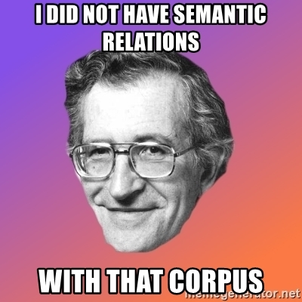



Standalone Packages, plugins, extensions
PyTextRank
Py impl of TextRank for lightweight phrase extraction
spacy-raspberry
64bit Raspberry Pi image for spaCy and neuralcoref
spacy-nlp
Expose spaCy NLP text parsing to Node.js (and other languages) via Socket.IO
spacy-sentiws
German sentiment scores with SentiWS
Sentence Segmenter
Custom sentence segmentation for spaCy
spaCy Server
🦜 Containerized HTTP API for spaCy NLP
spacy-transformers
spaCy pipelines for pretrained BERT, XLNet and GPT-2
spacy-stanza
Use the latest Stanza (StanfordNLP) research models directly in spaCy
spacy-vis
A visualisation tool for spaCy using Hierplane
spacymoji
Emoji handling and meta data as a spaCy pipeline component

Slide 64





Standalone Packages, plugins, extensions
textacy
NLP, before and after spaCy
textpipe
clean and extract metadata from text
torchtext
Data loaders and abstractions for text and NLP
whatlies
Make interactive visualisations to figure out 'what lies' in word embeddings.
wmd-relax
Calculates word mover's distance insanely fast
spacy-wordnet
WordNet meets spaCy
spacyr
An R wrapper for spaCy
CleanNLP
A tidy data model for NLP in R
Kindred
Biomedical relation extraction using spaCy
languagecrunch
NLP server for spaCy, WordNet and NeuralCoref as a Docker image

Slide 65
Hands-on
NLP_Basics_Demo
SparkNLP_PretrainedModelsUsage
Using Pre-trained Pipelines
Explain Document ML
Explain Document DL
Spell Checker
Parsing a list of texts
Using fullAnnotate to get more details
Use pretrained match_chunk Pipeline for Individual Noun Phrase
Extract exact dates from referential date phrases
Sentiment Analysis
spaCy_Demo
SparkNLP_Transformers
Legal Text Processing
Blackstone
Biomedical Text Processing
ScispaCy
Stanza (formerly StanfordNLP) library
Spacy-stanza , stanza

Slide 66
Pretrained Models
End-End Pipeline
Language Models
Demo - Using pretrained models

Slide 67
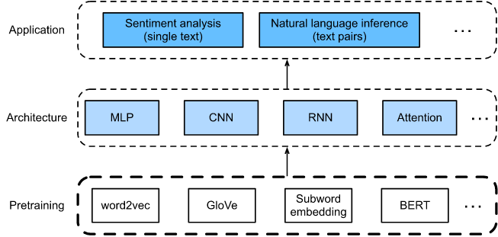
End to End Pipeline
Pretrained text representations can be fed to various deep learning architectures for different downstream natural language processing applications

Slide 68
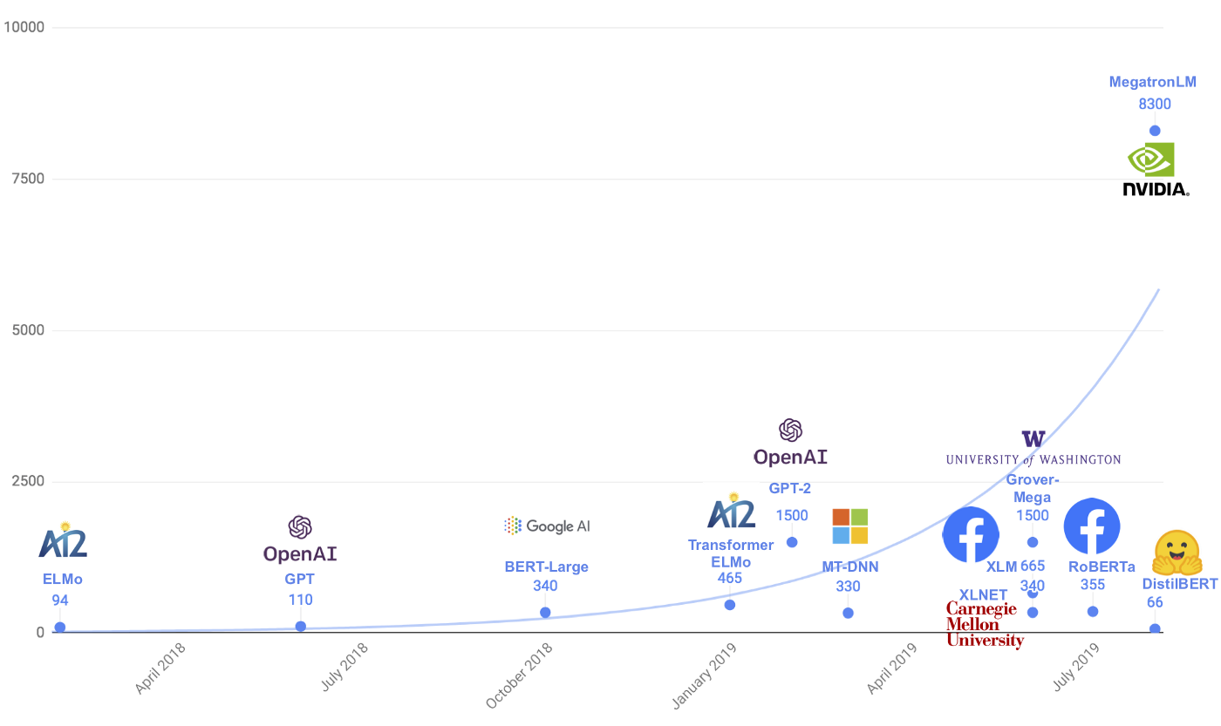
Pre-trained Language Models
Source
Notes:
Parameter counts of several recently released.
https://medium.com/@Moscow25/the-best-deep-natural-language-papers-you-should-read-bert-gpt-2-and-looking-forward-1647f4438797

Slide 69
Pretrained Models
DistilBERT (from HuggingFace)
CTRL (from Salesforce)
CamemBERT (from FAIR, Inria, Sorbonne Université)
ALBERT (from Google Research)
XLM-RoBERTa (from Facebook AI)
FlauBERT (from CNRS)
Bart (Facebook AI)
T5 (from Google)
ELECTRA (from Google)
DialoGPT (from Microsoft)
Reformer (from Google)
MarianMT (HuggingFace)
GPT-3 (from OpenAI)
BERT (from Google)
GPT (from OpenAI)
GPT-2 (from OpenAI)
Transformer-XL (from Google/CMU)
XLNet (from Google/CMU)
XLM (from Facebook)
RoBERTa (from Facebook)
Pretrained Models & Architecture Details

Slide 70
Deep Learning success in NLP: A non-exhaustive list
Named Entity Recognition
Machine Translation
Sequence Classification
Question Answering
Language Modeling
Summarization
Document Classification
Hands-on

Slide 71
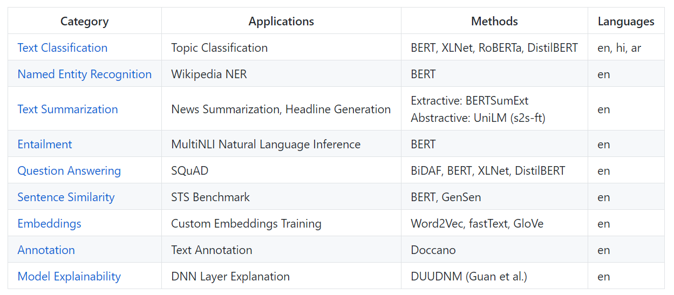

Slide 72
Conclusion
Enterprise Applications for NLP Technologies
Processing, Understanding, Generation
Software and Systems
High performance across many different NLP tasks.
Transfer Learning
Multimodal Deep Learning Systems
Explainable AI Models
Voice/speech recognition
Querying image content
Customer service & marketing virtual digital assistants (VDAs)
Patent research and analysis
Automated report generation
Patient data processing
Converting paperwork into digital data
Automated code development
44 NLP use cases

Slide 73
Thank you for listening
Queries?

